Slide 1
Will Trump tweets affect daily stock prices?
Group 14
Xiaolin Cao, Ting-Wei Lin, Ming-Chen Lu, Suzy McTaggart
Source: FactSet
Notes:
Motivation

Slide 2
Dataset Overview
Trump Tweets
Daily Stock Price
Data Frame
Labeling rise/fall of stock market
Date: May 4th 2009 - Sep 20th 2019
Tweet content
Retweets
Favorites
Presidency status: None, Candidate, President
Stock Market indicator
Text Preprocessing: split words, remove stopwords, compute sentiment score

Slide 3
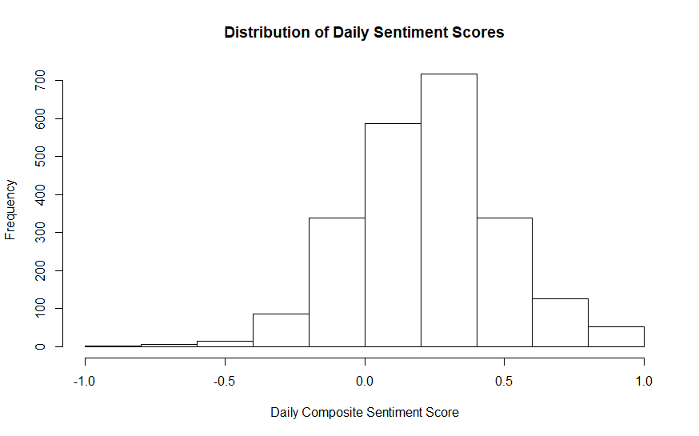
EDA - Tweet Words

Slide 4
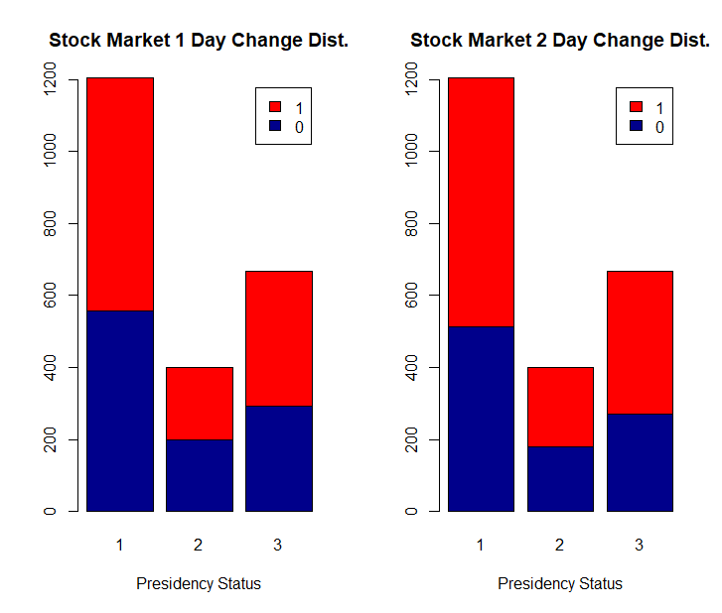
EDA - S&P Stock Price

Slide 5
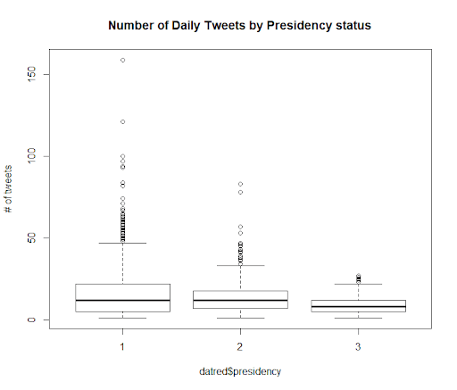
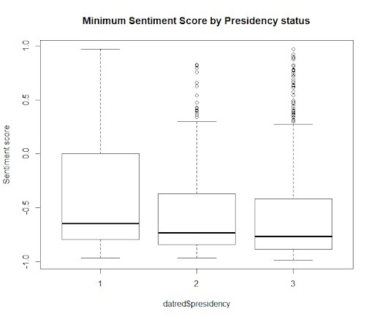
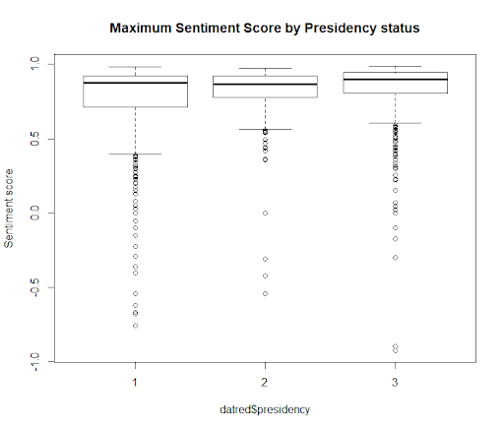
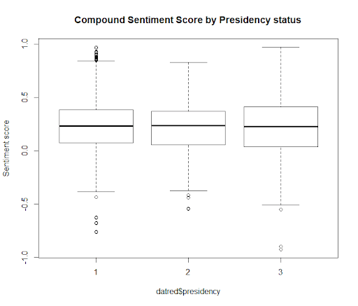
EDA - Tweet Words

Slide 6
Methods - Logistic Regression Modeling
Model Selection
Output variable dichotomized, Y is categorical
Logistic Regression makes fewer assumptions about the data compared to LDA, is robust to outliers and does not assume Gaussian Distribution
Decision Tree Classifier can be used for prediction of discrete sets of values and can be tuned to a best fit for the data to be modeled

Slide 7
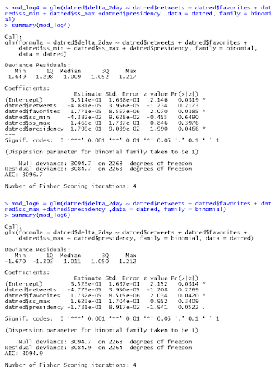
Methods - Logistic Regression Model
Notes:
In the initial/full model, # of favorites and presidency status were significant
The model was reduced using backward elimination
Presidency status was found to have an interaction with the daily minimum sentiment score
The tweets made by Donald Trump during his presidency (when they are more negative) and they receive more “favorite” ratings show significance to a model predicting whether the stock market will have a 2-day increase or decrease in value.

Slide 8
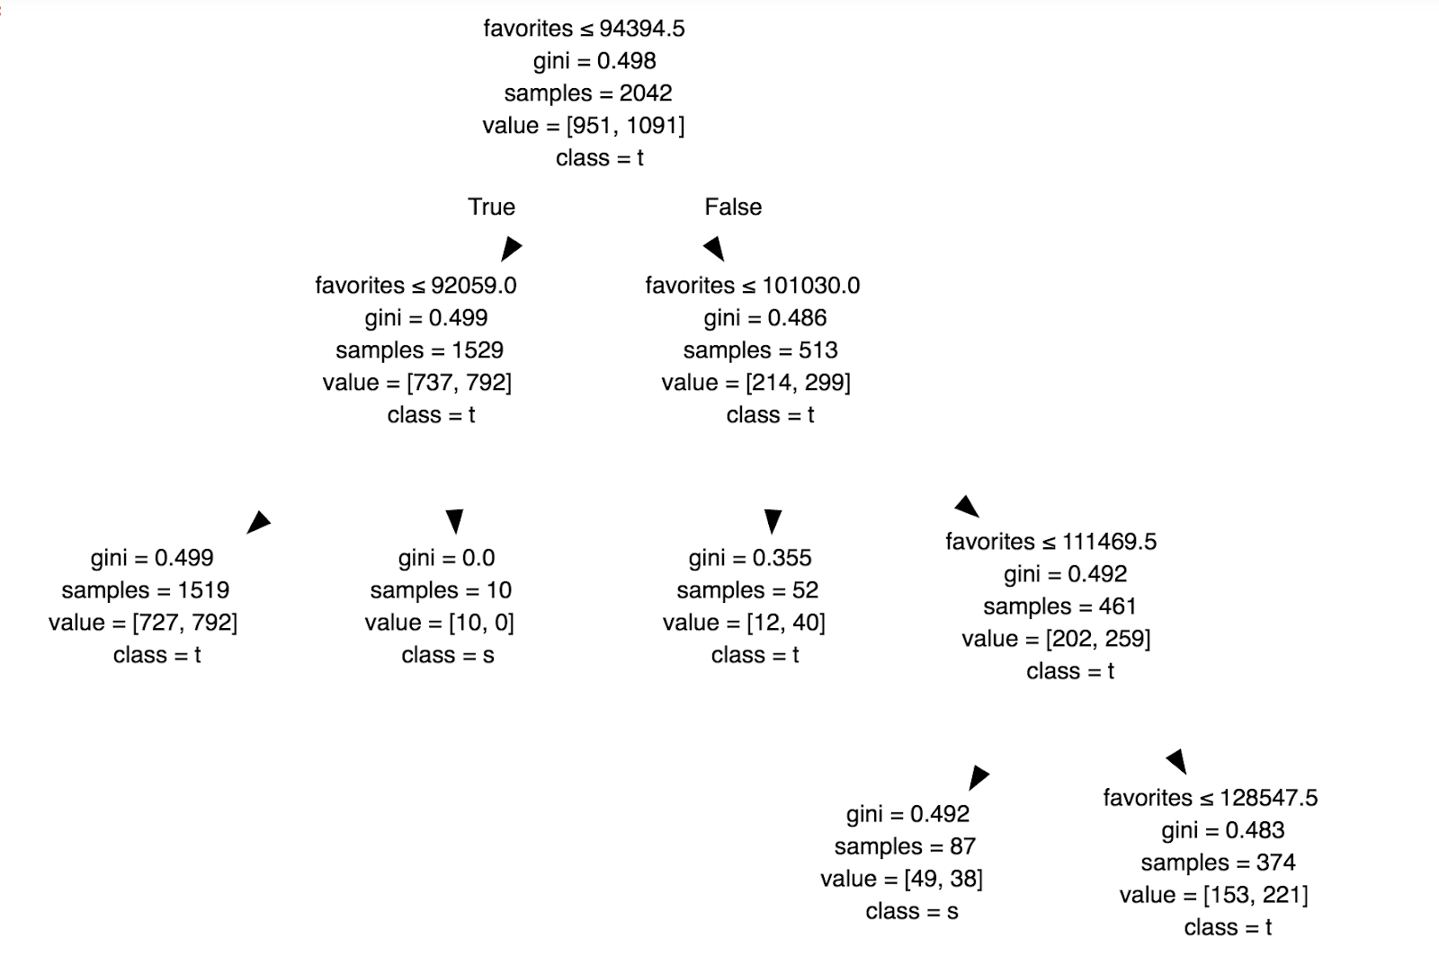
Methods - Decision Tree Classifier
Notes:
What is different from the logistic regression model:
did not incorporate the pre-presidency and post-presidency variable
Error rate on the test set is approximately 0.4, which is only slightly better than random guessing

Slide 9
Future Improvement
Incorporate the pre-presidency and post-presidency variable
Include text topics
Tune with different choices of parameters

Slide 10
Thank you for listening

